Slide 1
Antibiotic Drug Prescription 1
Team Member(s): Sean Iamartino, Alan Nieto
Product Owner(s): Giri Narasimhan
School of Computing and Information Sciences
Florida International University
Senior Project Introductory Video
Summer 2016
Notes:
Greet your audience, thank them for attending your presentation, introduce yourself, introduce your project, introduce your team members, and quickly indicate what each of you did in a high-level manner, and put more emphasis on your part/contribution.

Slide 2
Project definition
Antibiotic resistance is a major issue confronting healthcare providers and their patients. Changing antibiotic resistance patterns, rising antibiotic costs and the introduction to new antibiotics have made selecting optimal antibiotic regimens more difficult now than ever before.
Goal:
Create a mobile application:
Cross-platform
User-friendly
User-specific patients, that can be selected and evaluated
Intelligently suggest the proper antibiotic to be prescribed for the selected patient
Notes:
Introduce the problem that the whole project tackles and stay focused on the parts that you have been working. Indicate if there is an existing previous system, enumerate its problems/limitations, etc.

Slide 3
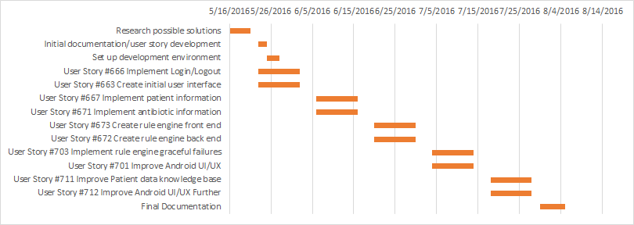
Project Management

Slide 4
User Stories Implemented
User Story #666 Implement Login/Logout
User Story #663 Create initial user interface
User Story #667 Implement patient information
User Story #671 Implement antibiotic information
User Story #673 Create rule engine front end
User Story #672 Create rule engine back end
User Story #703 Implement rule engine graceful failures
User Story #701 Improve Android UI/UX
User Story #711 Improve Patient data knowledge base
User Story #712 Improve Android UI/UX Further

Slide 5
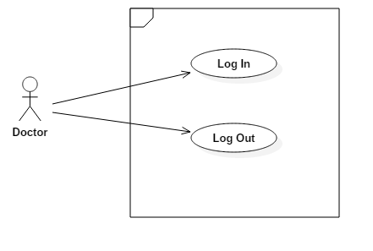
User Story #666 Implement Login/Logout

Slide 6
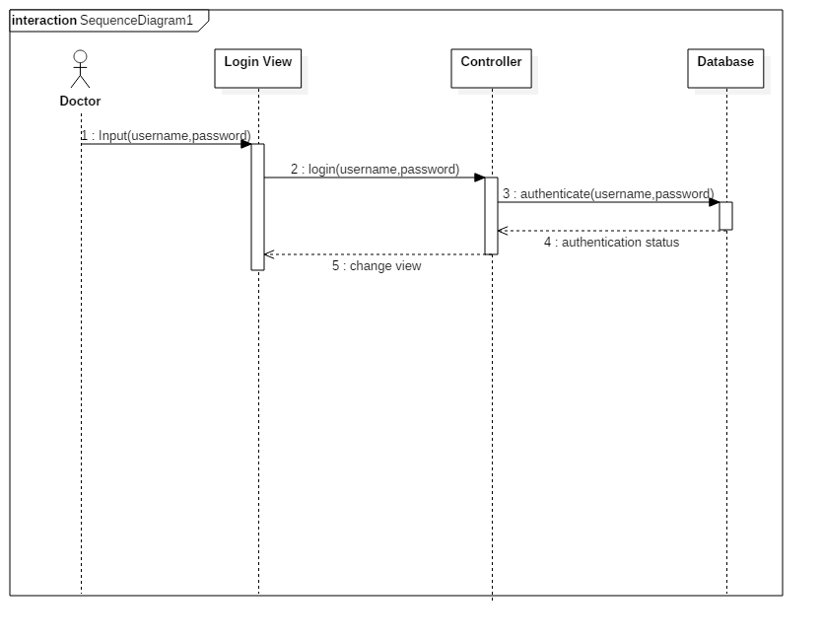
1. User Story #666 Implement Login/Logout

Slide 7
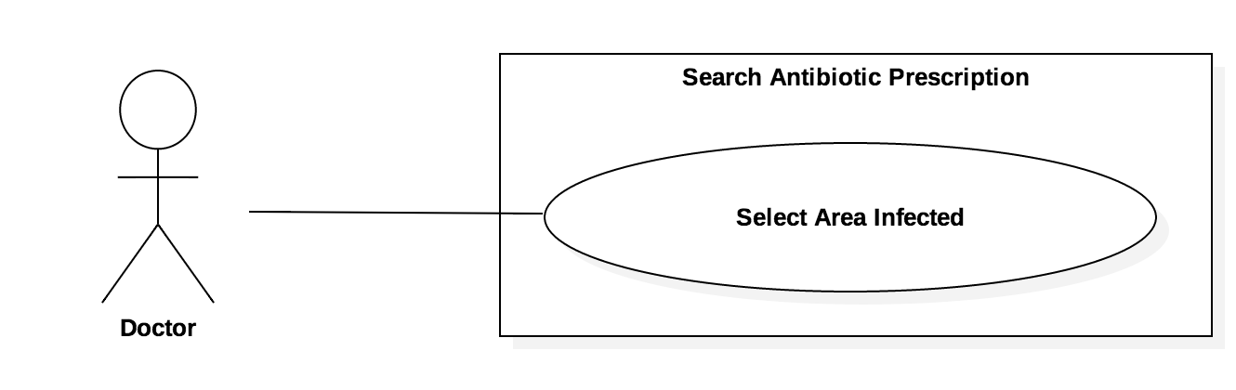
2. User Story #663 Create initial user interface

Slide 8
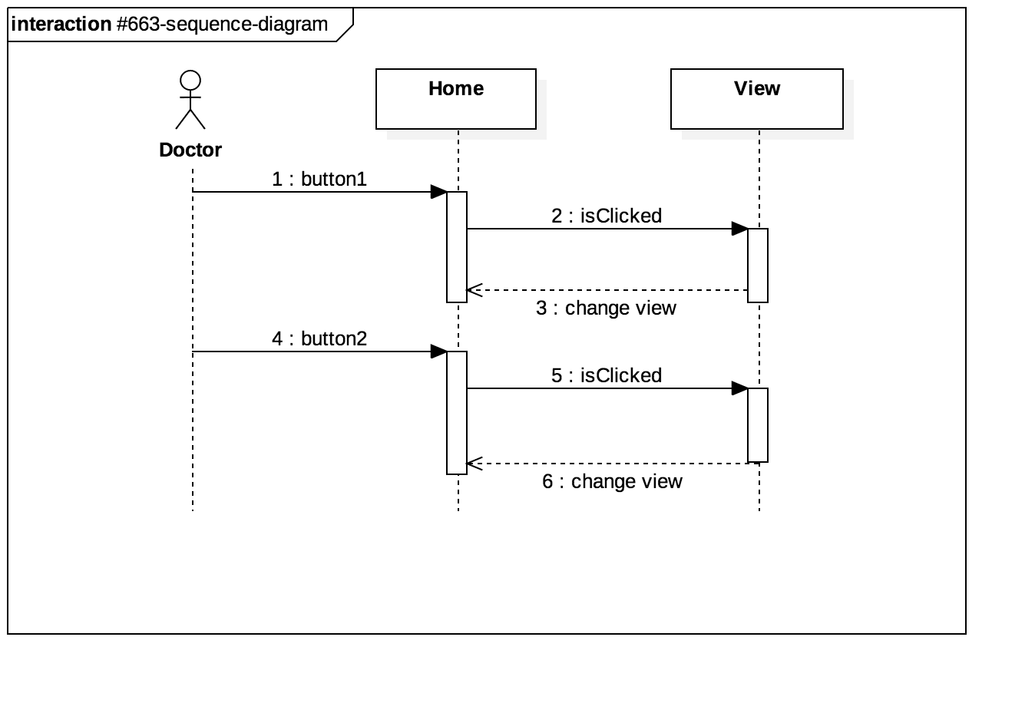
2. User Story #663 Create initial user interface

Slide 9
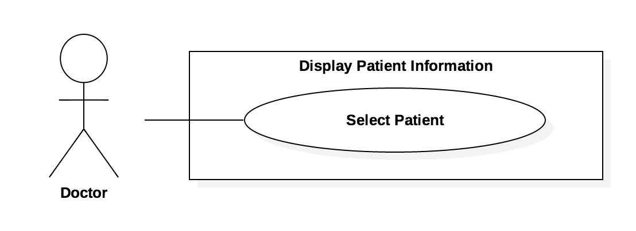
3. User Story #667 Implement patient information

Slide 10
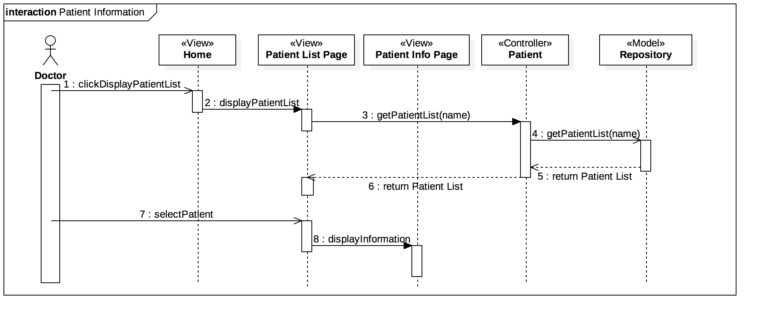
3. User Story #667 Implement patient information

Slide 11
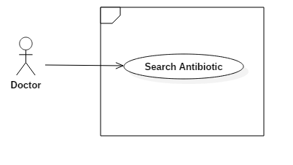
4. User Story #671 Implement antibiotic information

Slide 12
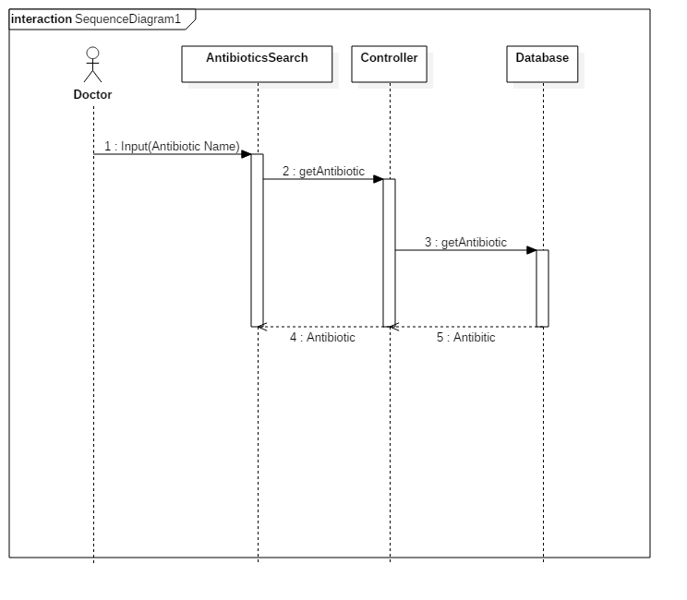
4. User Story #671 Implement antibiotic information

Slide 13
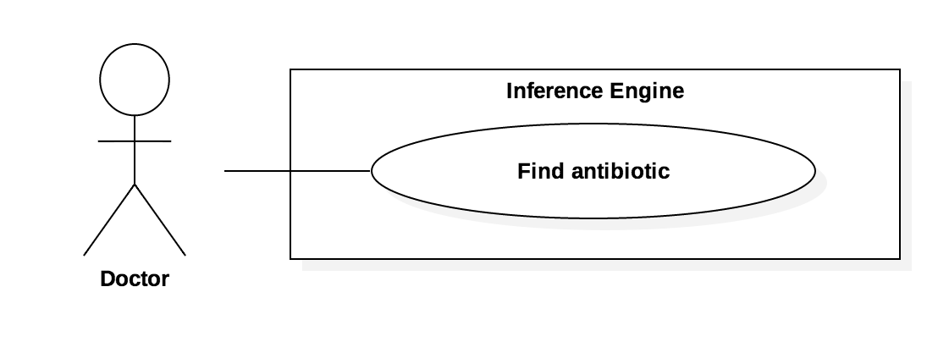
5. User Story #673 Create rule engine front end

Slide 14
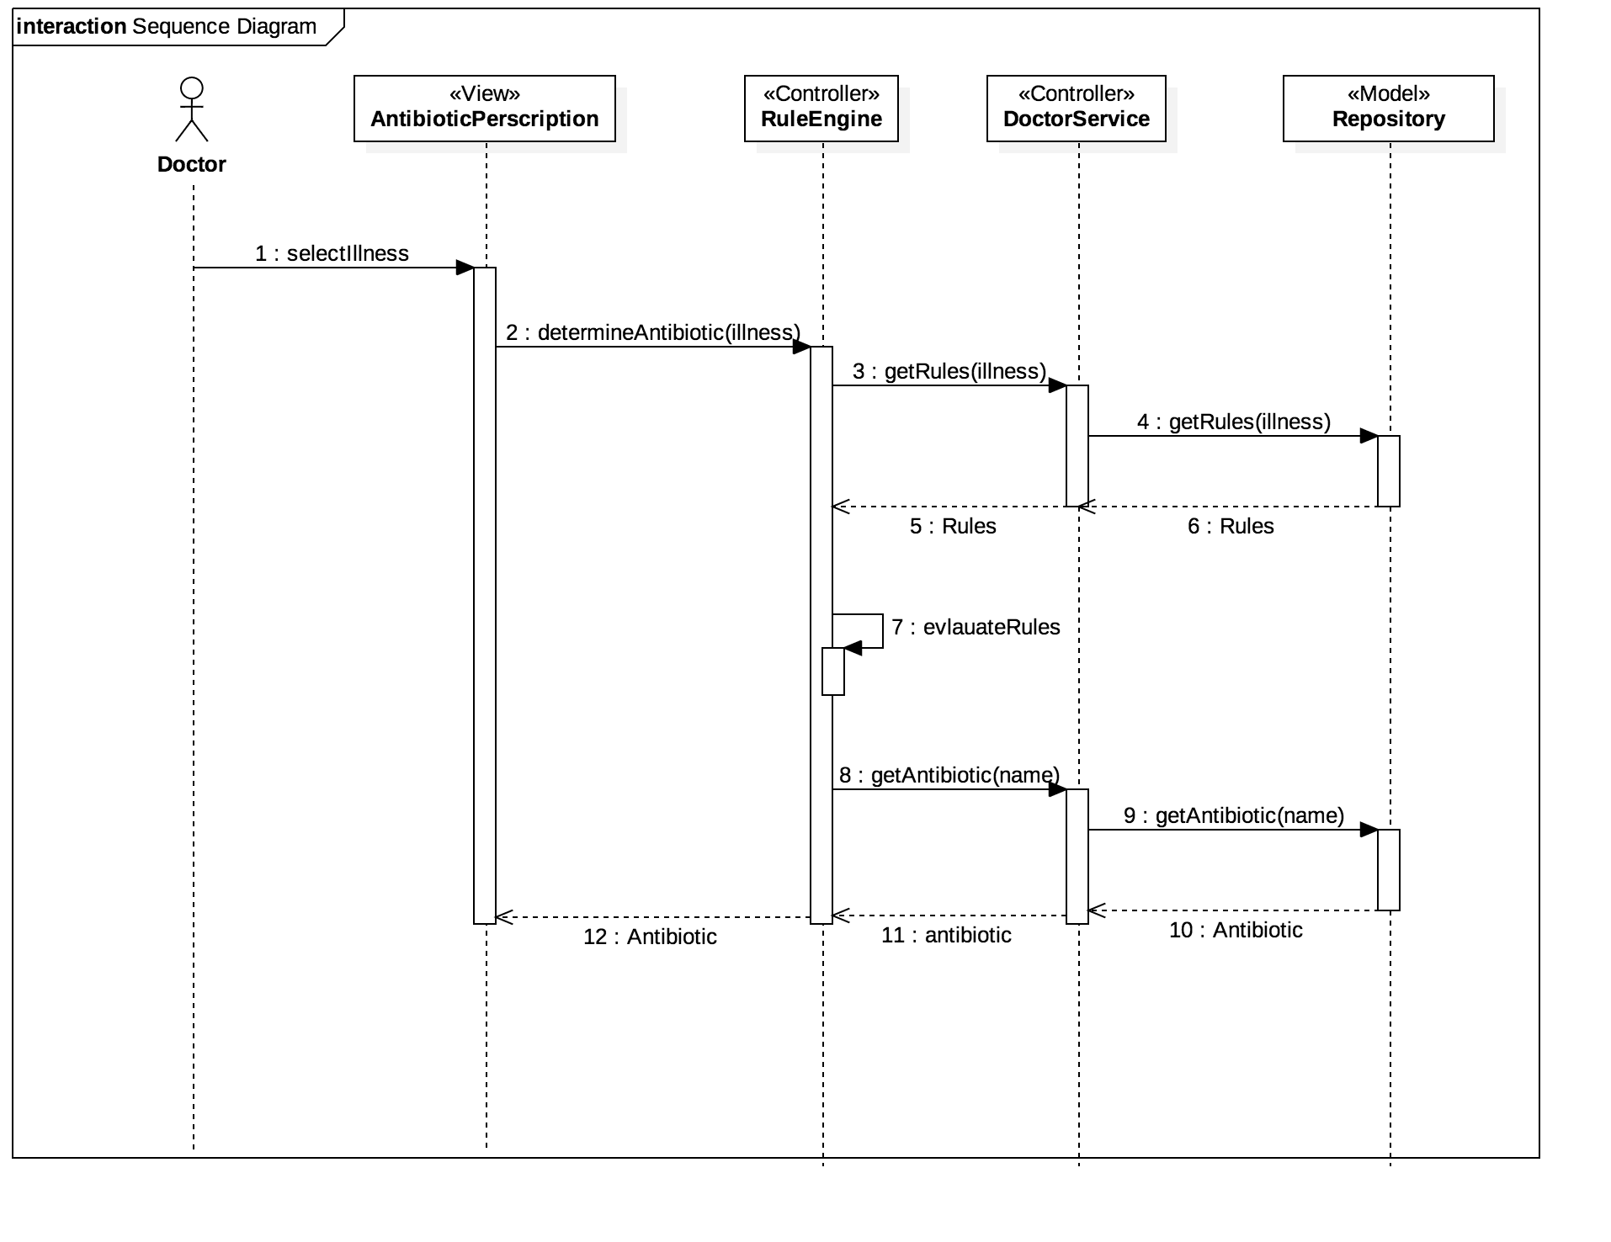
5. User Story #673 Create rule engine front end

Slide 15
6. User Story #672 Create rule engine back end

Slide 16
6. User Story #672 Create rule engine back end

Slide 17
7. User Story #703 Implement rule engine graceful failures

Slide 18
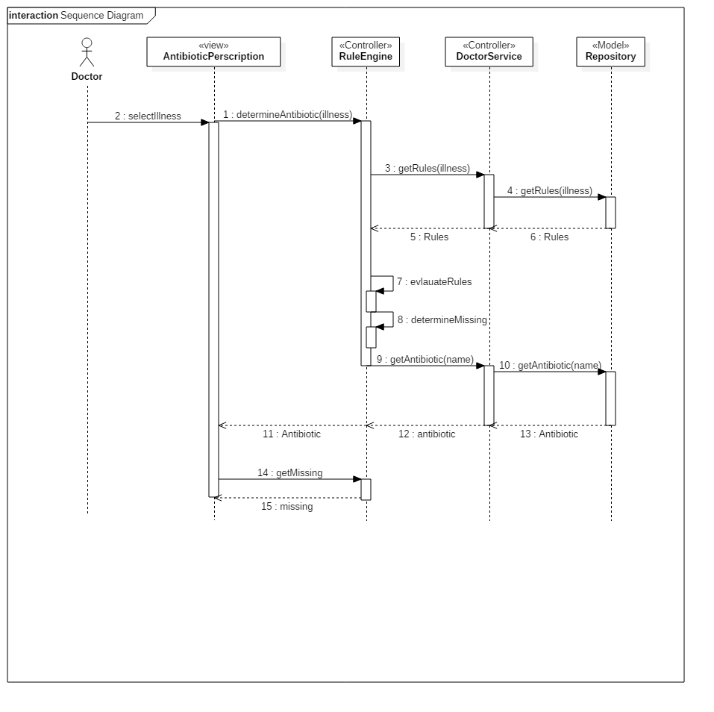
7. User Story #703 Implement rule engine graceful failures

Slide 19
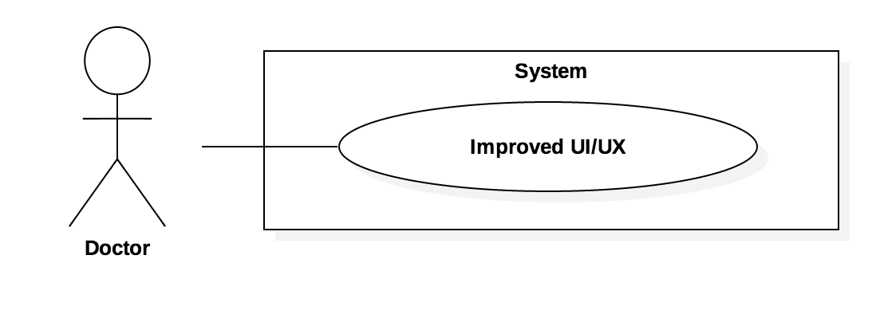
8. User Story #701 Improve Android UI/UX

Slide 20
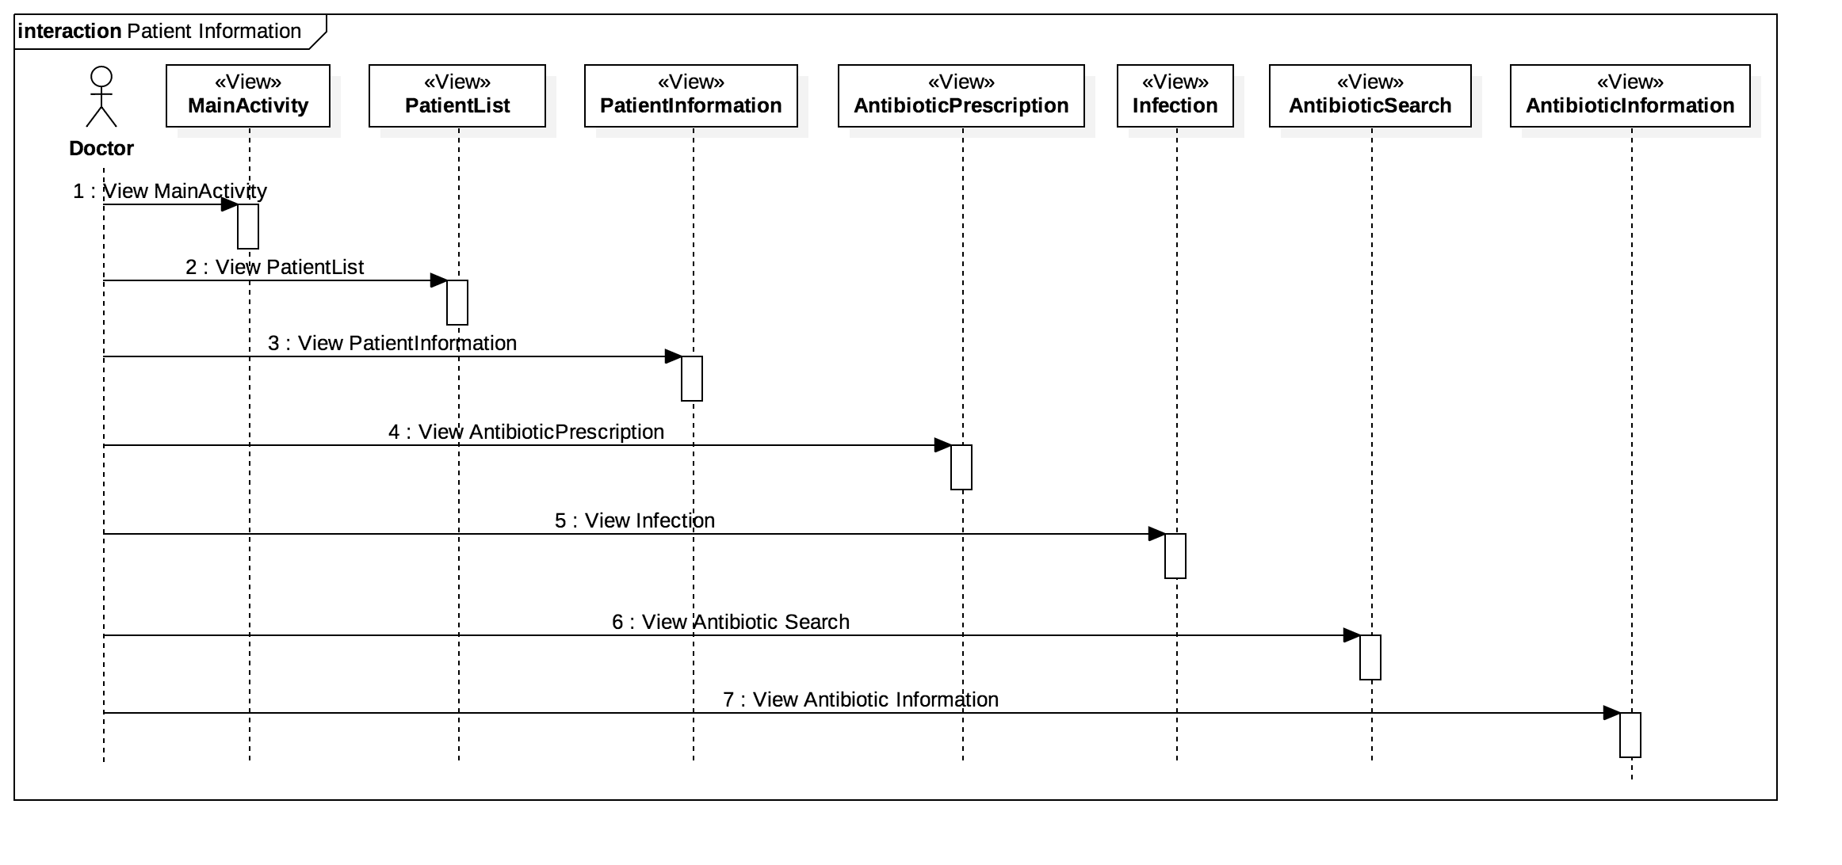
8. User Story #701 Improve Android UI/UX

Slide 21
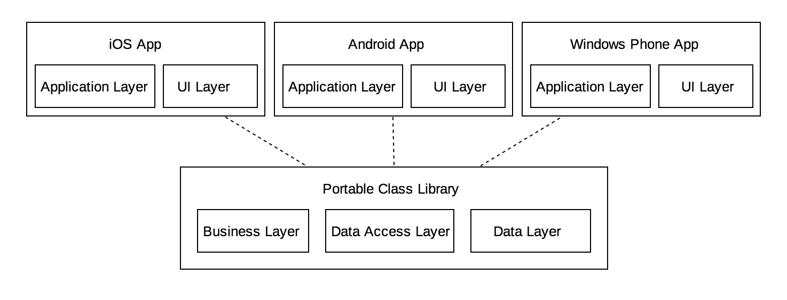
System Design

Slide 22
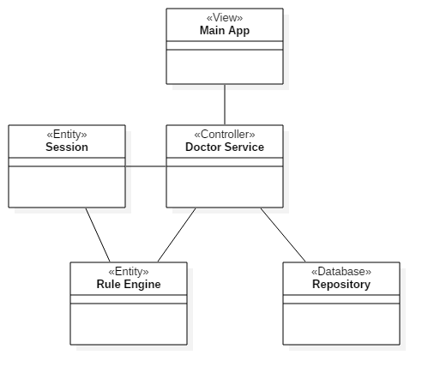
System Design

Slide 23
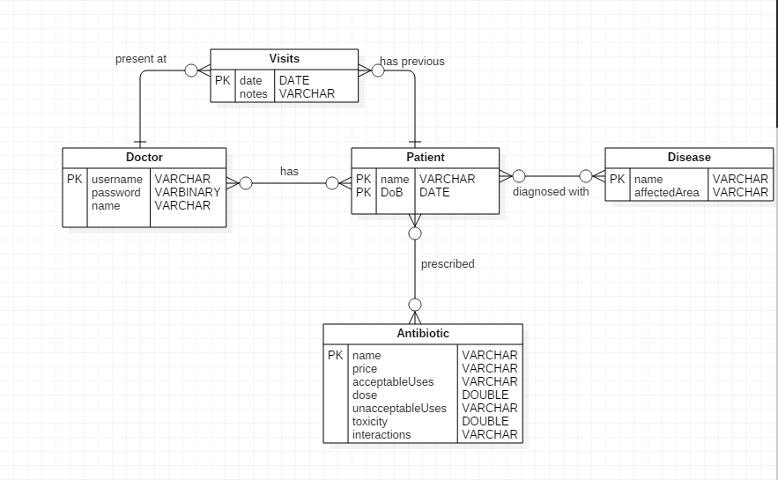
Data Design

Slide 24
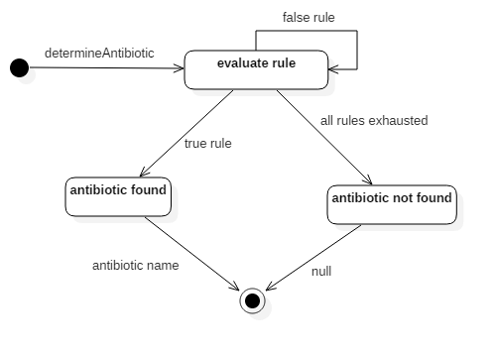
Rule Engine

Slide 25
Main Algorithm: Evaluating Rules
Rules take the form of “variable == value && variable == value && …”
Split the condition into multiple string by the ‘&&’ delimiter
For Each sub-condition created by splitting the initial condition:
  break it down further by applying the regular expression “\s*(\w+(\s*\w+)*)\s+([<>=]+)\s*(\w+(\s*\w+)*)”, forming 3 groups the left “variable” of the equation, the operator, and the right “value” of the equation.
  using the variable, check if it exists in the patient knowledge base
    if it exists compare the value section to what exists in the knowledge
      if the value is the same return true
      otherwise return false
    otherwise return false

Slide 26
Test Cases
Sunny Day
Test ID: U672-TC002
Purpose: Evaluate condition returns true with a true conditional string(real application)
Preconditions: Knowledge: community acquired = true, severely ill = false, PCN allergy = no Condition: community acquired == true & severely ill == false & PCN allergy == no
Input: evaluateCondition(condition, knowledge)
Expected Result: true

Slide 27
Test Cases
Rainy Day
Test ID: U672-TC003
Purpose: Evaluate condition returns false with a false conditional string
Preconditions: Knowledge: community acquired = true, severely ill = false, PCN allergy = no Condition: community acquired == false & severely ill == false & PCN allergy = no
Input: evaluateCondition(condition, knowledge)
Expected Result: false

Slide 28
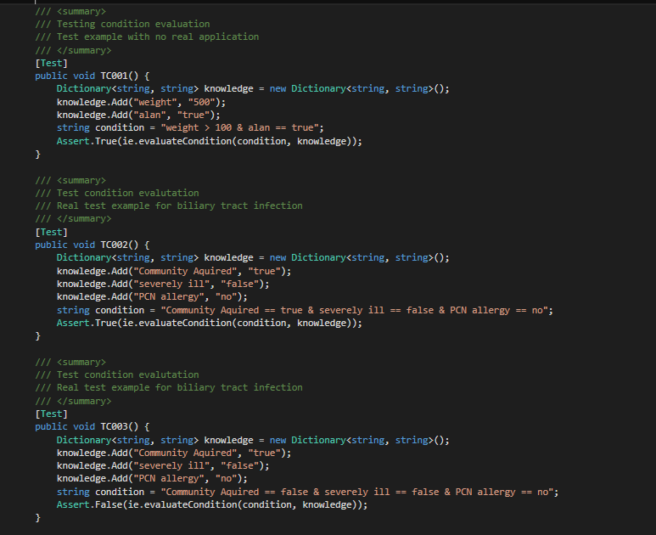
Automated Test Scripts

Slide 29
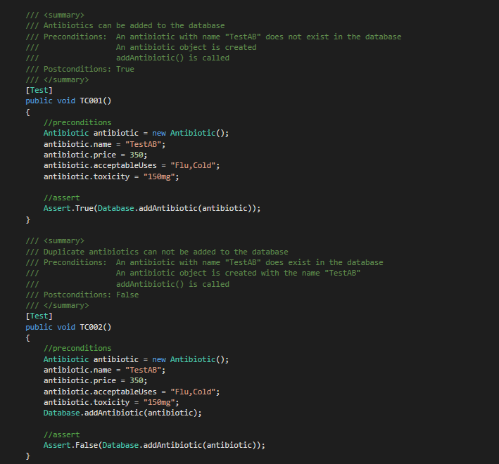
Automated Test Scripts Contd.

